Slide 1

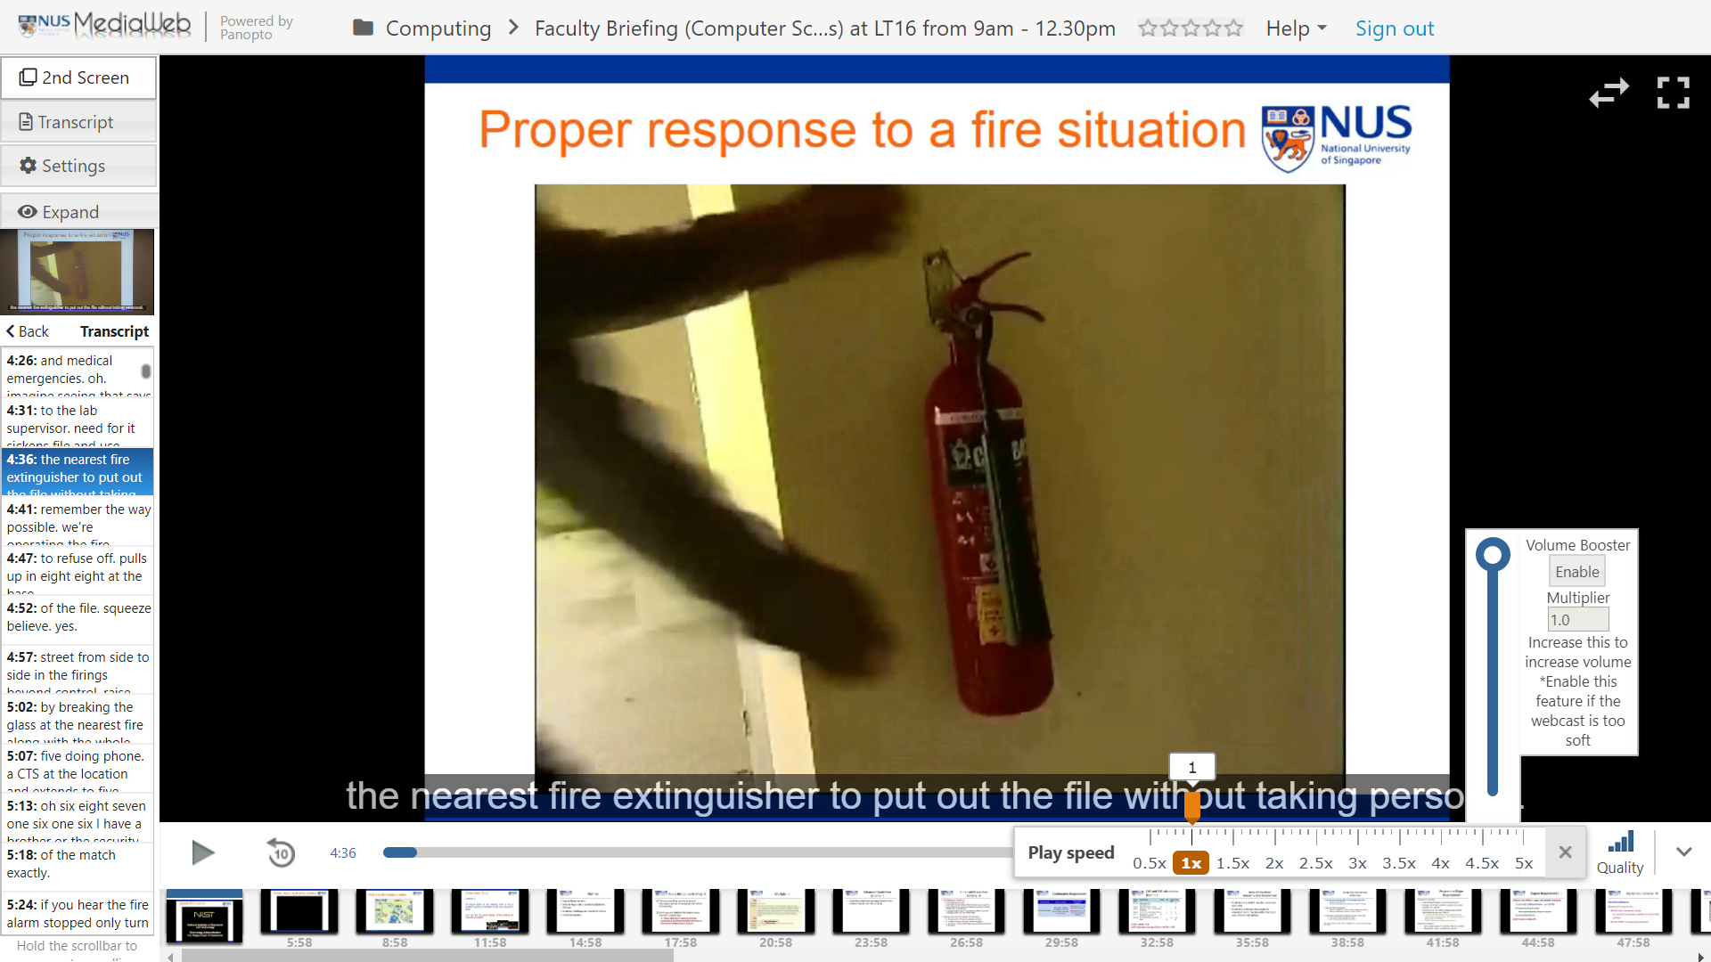
anopto Plus
Sidebar navbar
Responsiveness
Silence Trimming
Transcript
Subtitles
(synced on both video streams)
Subtitles
(synced on both video streams)
Volume Booster
Playback speed slider
Smaller Carousel
Customizable UI
Usable on all NUS webcasts
Milestone 3 Submission By Group 1 Matthew & Fyonn
Stay tuned for more upcoming features:
Volume Booster
(Increase volume beyond maximum)
Retractable sidebar
Transcript (stand-alone sidebar & below screen)
Finished Settings tab
Customizable carousel
Responsiveness (still able to watch webcast with browser minimized)

